Slide 1

Hw11 – Student future earnings
Ryan Coslove rmc326

Slide 2
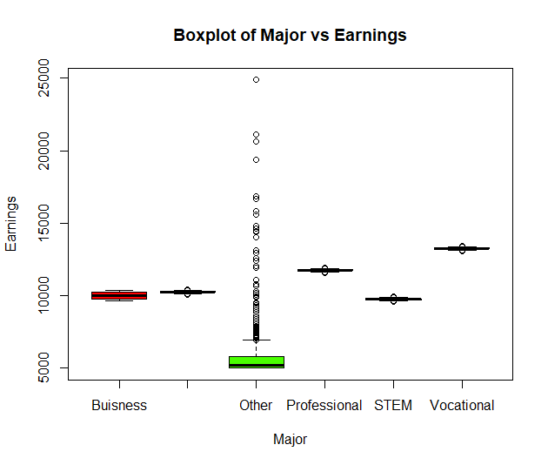
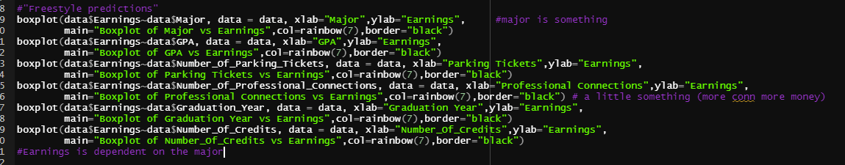
Plots
I began with some plots, trying to find trends between Earnings and other categories.
I found Major had the largest influence, followed by Professional Connections

Slide 3
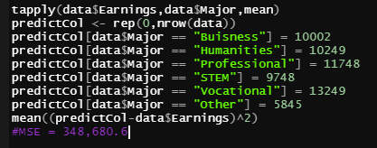
MSE
Based on the following snippet of code, I found the MSE was 348,680.6

Slide 4
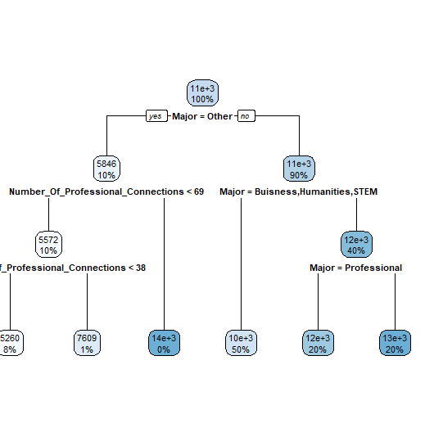
Rpart Tree
It was important to combine Major and Number of Professional Connections as the variables of the rpart tree because they had the strongest influence on earnings.
tree <- rpart(Earnings ~Major+Number_Of_Professional_Connections,data=data)
pred = predict(tree, newdata = data)
mean((pred-data$Earnings)^2)
#MSE = 93,603.13

Slide 5
Random forest
I used random forest to predict the Earnings variable, and used all the other attributes to make the prediction mode.
Code:
rf <- randomForest::randomForest(Earnings ~ ., data = data)
#MSE = 17,750.78

Slide 6
Conclusions
We could see that as we went from basic tapply predictions to rpart to random forest that our MSE got closer to 0.
I then created my submission file using random forest as the source of my predictions

